Slide 1
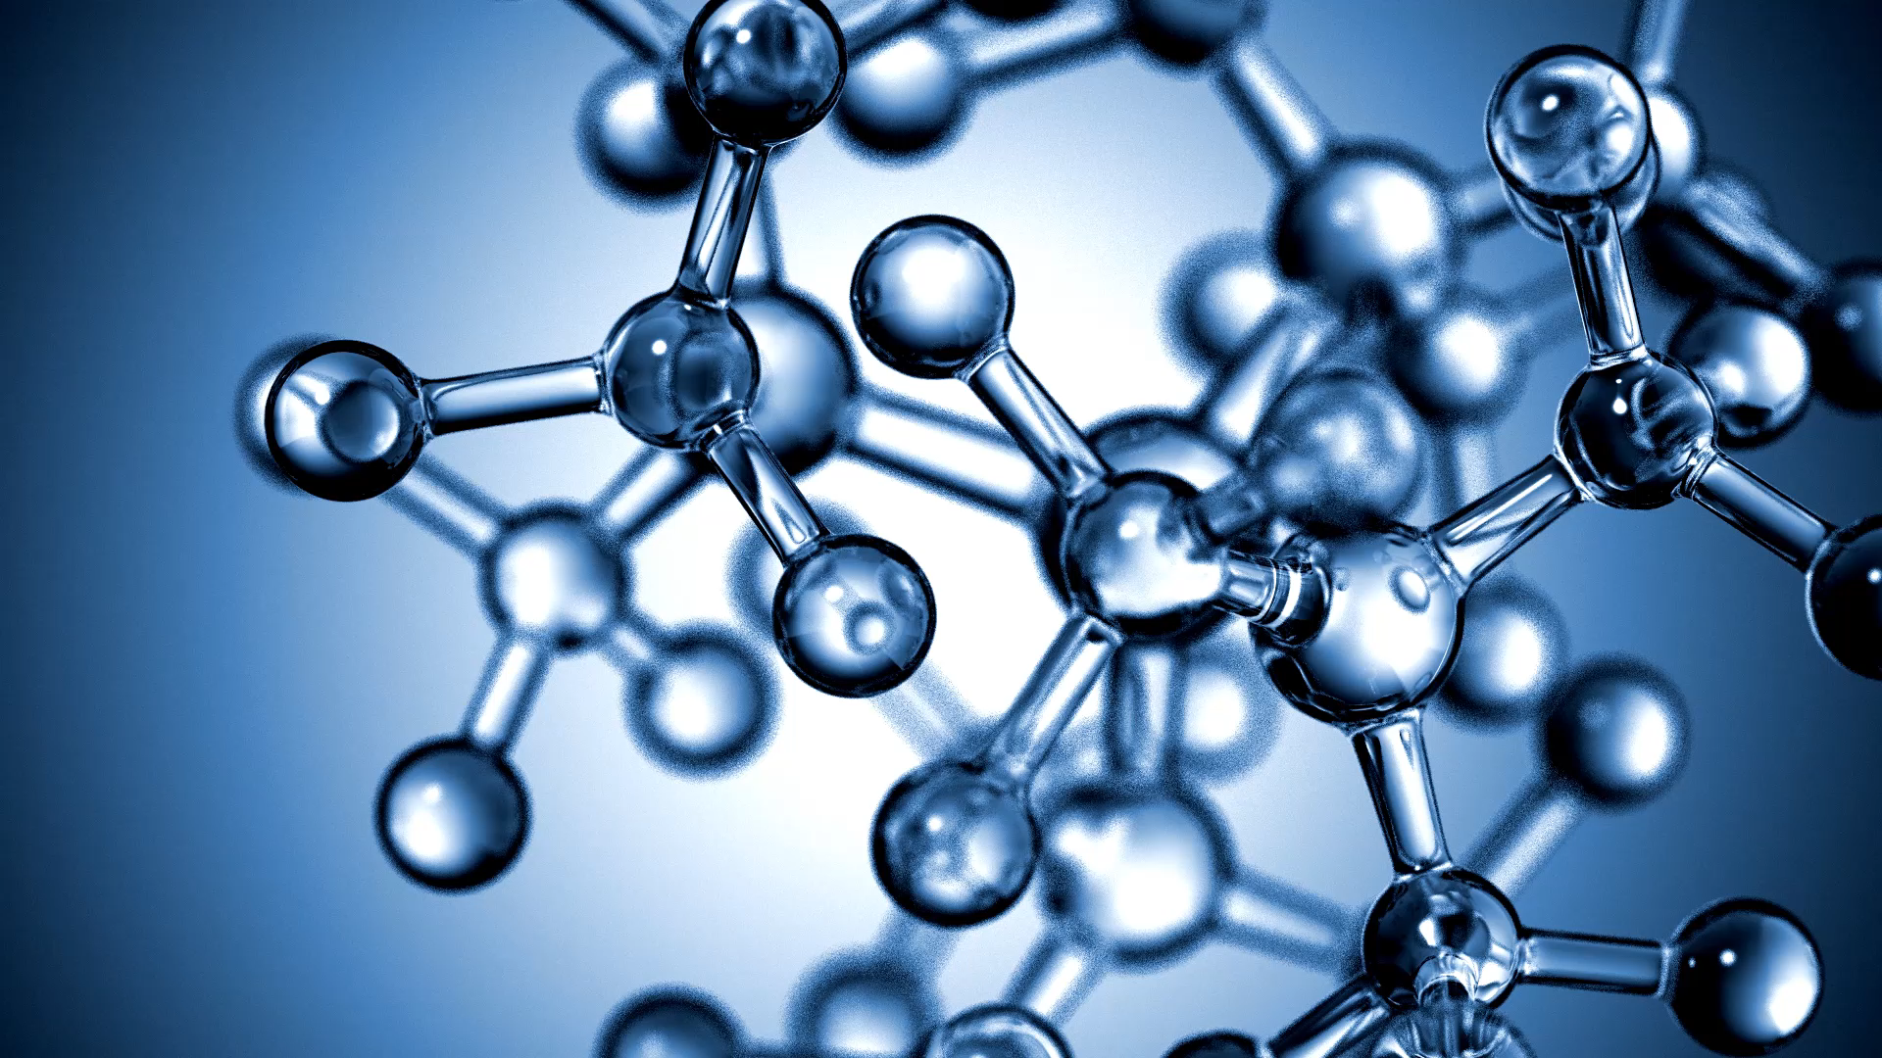
Predictive Models for Integrating Clinical and Genomic Data

Slide 2
What is the phenotype algorithm?
Phenotyping algorithms enable the interpretation of complex health data and definition of clinically relevant phenotypes; they have become crucial in biomedical research.

Slide 3
What is phenotype?
The set of observable characteristics of an individual resulting from the interaction of its genotype with the environment.

Slide 4
Genomic Data Analysis
A significant number of diseases are genetic in nature, but the nature of the causality between the genetic markers and the diseases has not been fully established.
For example, diabetes is well known to be a genetic disease;
however, the full set of genetic markers that make an individual prone to diabetes are unknown.
In some other cases, such as the blindness caused by Stargardt disease, the relevant genes are known but all the possible mutations have not been exhaustively isolated.
Clearly, a broader understanding of the relationships between various genetic markers, mutations, and disease conditions has significant potential in assisting the development of various gene therapies to cure these conditions

Slide 5
About the Genomic Data Analysis Network
While large genomic datasets are invaluable to the cancer research community, translating genomic data into biological insights into the development and treatment of cancer is not a straightforward task.
Over a decade of experience from The Cancer Genome Atlas (TCGA) program demonstrated that successful analyses of large-scale genomic datasets require the coordination of a large body of researchers with a wide range of expertise in computational genomics, tumor biology, and clinical oncology.

Slide 6
DNA Mutations –
Identifying mutations in coding and non-coding regions of the genome, classifying mutations as driver or passenger mutations, identifying chromosomal rearrangement events leading to fusion proteins, and determining potential enhancer or suppressor functionality of mutations.

Slide 7
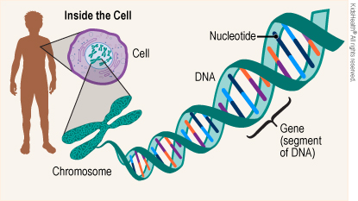

Slide 8
What Causes a Gene Mutation?
A gene can mutate because of:
a change in one or more nucleotides of DNA
a change in many genes
loss of one or more genes
rearrangement of genes or whole chromosomes

Slide 9
Do Parents Pass Gene Mutations to Children?
If a parent carries a gene mutation in their egg or sperm, it can pass to their child.
These hereditary (or inherited) mutations are in almost every cell of the person's body throughout their life.
Hereditary mutations include cystic fibrosis, hemophilia, and sickle cell disease.

Slide 10

What Is Cystic Fibrosis?
Cystic fibrosis (CF) is a genetic condition that affects a protein in the body.
People who have cystic fibrosis have a faulty protein that affects the body’s cells, its tissues, and the glands that make mucus and sweat.
Normal mucus is slippery and protects the airways, digestive tract, and other organs and tissues.
Cystic fibrosis causes mucus to become thick and sticky.
As mucus builds up, it can cause blockages, damage, or infections in affected organs.

Slide 11
Importance of chloride ions
Inside the lung, an ion channel known as CFTR provides a route for chloride ions to move out of cells, which helps clear harmful material from the airways. Mutations affecting this protein cause the mucus lining the airways to become very sticky, leading to a severe disease known as cystic fibrosis.
The full form of CFTR is Cystic Fibrosis Transmembrane Conductance Regulator

Slide 12
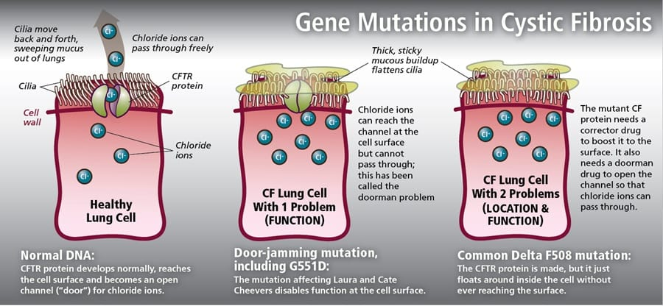

Slide 13
Haemophillia
Hemophilia is caused by a mutation or change, in one of the genes, that provides instructions for making the clotting factor proteins needed to form a blood clot.
This change or mutation can prevent the clotting protein from working properly or to be missing altogether.
These genes are located on the X chromosome.

Slide 14
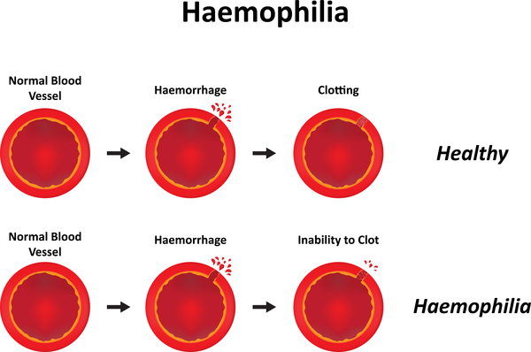

Slide 15
Haemophilia
Hemophilia is an inherited disease, most commonly affecting males, that is characterized by a deficiency in blood clotting.
The responsible gene is located on the X chromosome, and since males inherit only one copy of the X chromosome, if that chromosome carries the mutated gene then they will have the disease.
Females have a second, usually normal, copy of the gene on their other X chromosome, so they capable of passing on the disease without experiencing its symptoms.

Slide 16
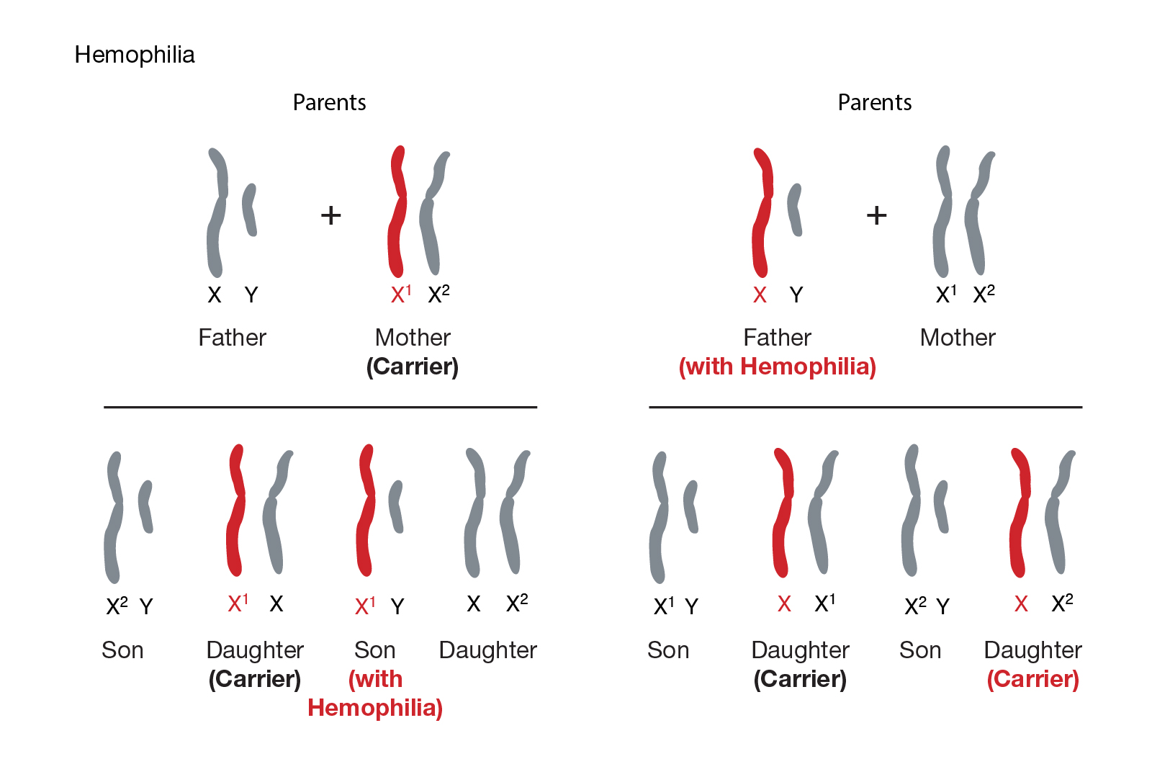

Slide 17
Mutations
Other mutations can happen on their own during a person's life.
These are called sporadic, spontaneous, or new mutations.
They affect only some cells. Damage from the sun's ultraviolet radiation or exposure to some types of chemicals can lead to new mutations.
These mutations are not passed from parents to their children.

Slide 18
Gene Expression
– Identifying mRNA expression patterns and correlating with relevant clinical parameters, identifying translocation or rearrangement events.
mRNA, or messenger RNA, is a type of genetic material that carries instructions from DNA to the protein-making machinery of cells, playing a crucial role in protein synthesis and gene expression.
mRNA characterization involves analyzing and understanding various aspects including structure, function, stability, abundance and interactions with other cellular components.

Slide 19
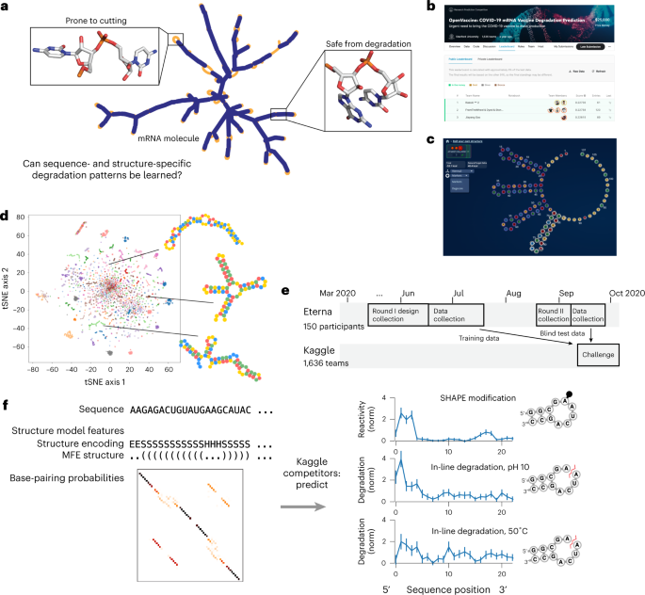

Slide 20
Copy number and tumor purity
- Clustering cases according to copy number alteration or loss-of-heterozygosity events, identifying candidate drivers of copy number alterations, estimating tumor purity of the samples.

Slide 21
What is copy number in cancer?
Copy number alterations (CNAs) are somatic changes to chromosome structure that result in gain or loss in copies of sections of DNA, and are prevalent in many types of cancer .

Slide 22
What is tumor purity?
Tumor purity refers to the proportion of tumor cells in the tumor microenvironment (TME).
TME includes a variety of cell populations, such as stromal cells, fibroblasts, endothelial cells, and immune cells, which play key roles in tumor occurrence and development

Slide 23
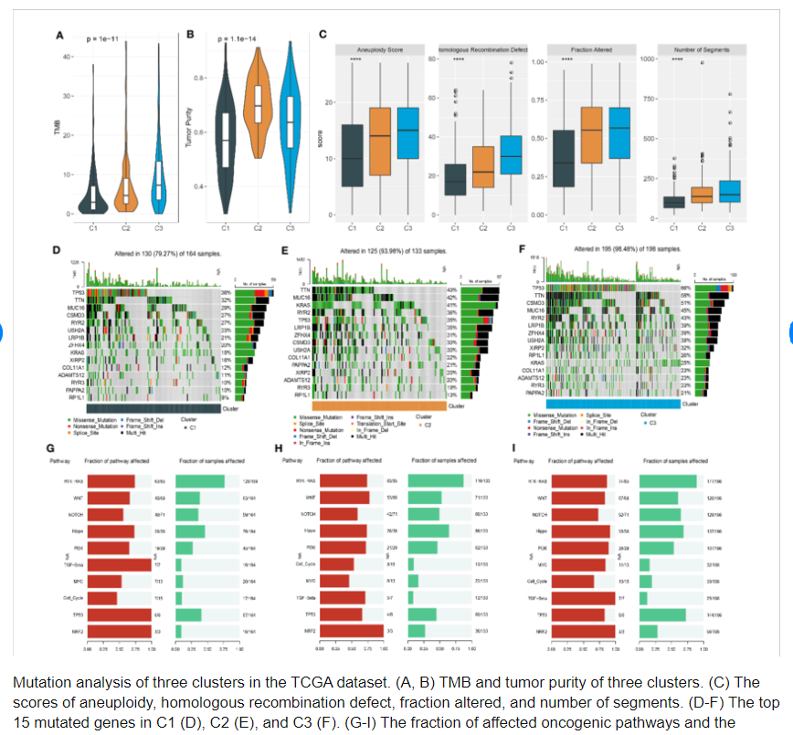

Slide 24
https://www.kaggle.com/datasets/nahin333/tcgaluad?resource=download

Slide 25
Problem Statment
Most of us know someone who struggled with breast cancer, or at least heard about the struggles facing patients who are fighting against breast cancer. Breast cancer is the most frequent cancer among women, impacting 2.1 million women each year. Breast cancer causes the greatest number of cancer-related deaths among women. In 2018 alone, it is estimated that 627,000 women died from breast cancer.
The most important part of a process of clinical decision-making in patients with cancers in general is the accurate estimation of prognosis and survival duration.

Slide 26
Cancer treatment
Breast cancer patients with the same stage of disease and the same clinical characteristics can have different treatment responses and overall survival, but why?
Cancers are associated with genetic abnormalities.
Gene expression measures the level of gene activity in a tissue and gives information about its complex activities.

Slide 27
Name | Type | Description
patient_id | object | Patient ID
age_at_diagnosis | float | Age of the patient at diagnosis time
type_of_breast_surgery | object | Breast cancer surgery type: 1- MASTECTOMY, which refers to a surgery to remove all breast tissue from a breast as a way to treat or prevent breast cancer. 2- BREAST CONSERVING, which refers to a urgery where only the part of the breast that has cancer is removed
cancer_type | object | Breast cancer types: 1- Breast Cancer or 2- Breast Sarcoma
cancer_type_detailed | object | Detailed Breast cancer types: 1- Breast Invasive Ductal Carcinoma 2- Breast Mixed Ductal and Lobular Carcinoma 3- Breast Invasive Lobular Carcinoma 4- Breast Invasive Mixed Mucinous Carcinoma 5- Metaplastic Breast Cancer
cellularity | object | Cancer cellularity post chemotherapy, which refers to the amount of tumor cells in the specimen and their arrangement into clusters
chemotherapy | int | Whether or not the patient had chemotherapy as a treatment (yes/no)

Slide 28
pam50_+_claudin-low_subtype | object | Pam 50: is a tumor profiling test that helps show whether some estrogen receptor-positive (ER-positive), HER2-negative breast cancers are likely to metastasize (when breast cancer spreads to other organs). The claudin-low breast cancer subtype is defined by gene expression characteristics, most prominently: Low expression of cell–cell adhesion genes, high expression of epithelial–mesenchymal transition (EMT) genes, and stem cell-like/less differentiated gene expression patterns
cohort | float | Cohort is a group of subjects who share a defining characteristic (It takes a value from 1 to 5)
er_status_measured_by_ihc | float | To assess if estrogen receptors are expressed on cancer cells by using immune-histochemistry (a dye used in pathology that targets specific antigen, if it is there, it will give a color, it is not there, the tissue on the slide will be colored) (positive/negative)
er_status | object | Cancer cells are positive or negative for estrogen receptors
neoplasm_histologic_grade | int | Determined by pathology by looking the nature of the cells, do they look aggressive or not (It takes a value from 1 to 3)
her2_status_measured_by_snp6 | object | To assess if the cancer positive for HER2 or not by using advance molecular techniques (Type of next generation sequencing)
her2_status | object | Whether the cancer is positive or negative for HER2
tumor_other_histologic_subtype | object | Type of the cancer based on microscopic examination of the cancer tissue (It takes a value of 'Ductal/NST', 'Mixed', 'Lobular', 'Tubular/ cribriform', 'Mucinous', 'Medullary', 'Other', 'Metaplastic' )

Slide 29
hormone_therapy | int | Whether or not the patient had hormonal as a treatment (yes/no)
inferred_menopausal_state | object | Whether the patient is is post menopausal or not (post/pre)
integrative_cluster | object | Molecular subtype of the cancer based on some gene expression (It takes a value from '4ER+', '3', '9', '7', '4ER-', '5', '8', '10', '1', '2', '6')
primary_tumor_laterality | object | Whether it is involving the right breast or the left breast
lymph_nodes_examined_positive | float | To take samples of the lymph node during the surgery and see if there were involved by the cancer
mutation_count | float | Number of gene that has relevant mutations
nottingham_prognostic_index | float | It is used to determine prognosis following surgery for breast cancer. Its value is calculated using three pathological criteria: the size of the tumour; the number of involved lymph nodes; and the grade of the tumour.
oncotree_code | object | The OncoTree is an open-source ontology that was developed at Memorial Sloan Kettering Cancer Center (MSK) for standardizing cancer type diagnosis from a clinical perspective by assigning each diagnosis a unique OncoTree code.
overall_survival_months | float | Duration from the time of the intervention to death

Slide 30

The Integrative Cluster subtypes (IntClusts)
The Integrative Cluster subtypes (IntClusts) provide a framework for the classification of breast cancer tumors into 10 distinct groups based on copy number and gene expression,
each with unique biological drivers of disease and clinical prognoses.
Gene expression data is often lacking, and accurate classification of samples into IntClusts with copy number data alone is essential.

Slide 31
overall_survival | object | Target variable wether the patient is alive of dead.
pr_status | object | Cancer cells are positive or negative for progesterone receptors
radio_therapy | int | Whether or not the patient had radio as a treatment (yes/no)
3-gene_classifier_subtype | object | Three Gene classifier subtype It takes a value from 'ER-/HER2-', 'ER+/HER2- High Prolif', nan, 'ER+/HER2- Low Prolif','HER2+'
tumor_size | float | Tumor size measured by imaging techniques
tumor_stage | float | Stage of the cancer based on the involvement of surrounding structures, lymph nodes and distant spread
death_from_cancer | int | Wether the patient's death was due to cancer or not (yes/no)

